Slide 1
The Development of The Sub Shop
Coty piechocki
Scott Chernoff

Slide 2
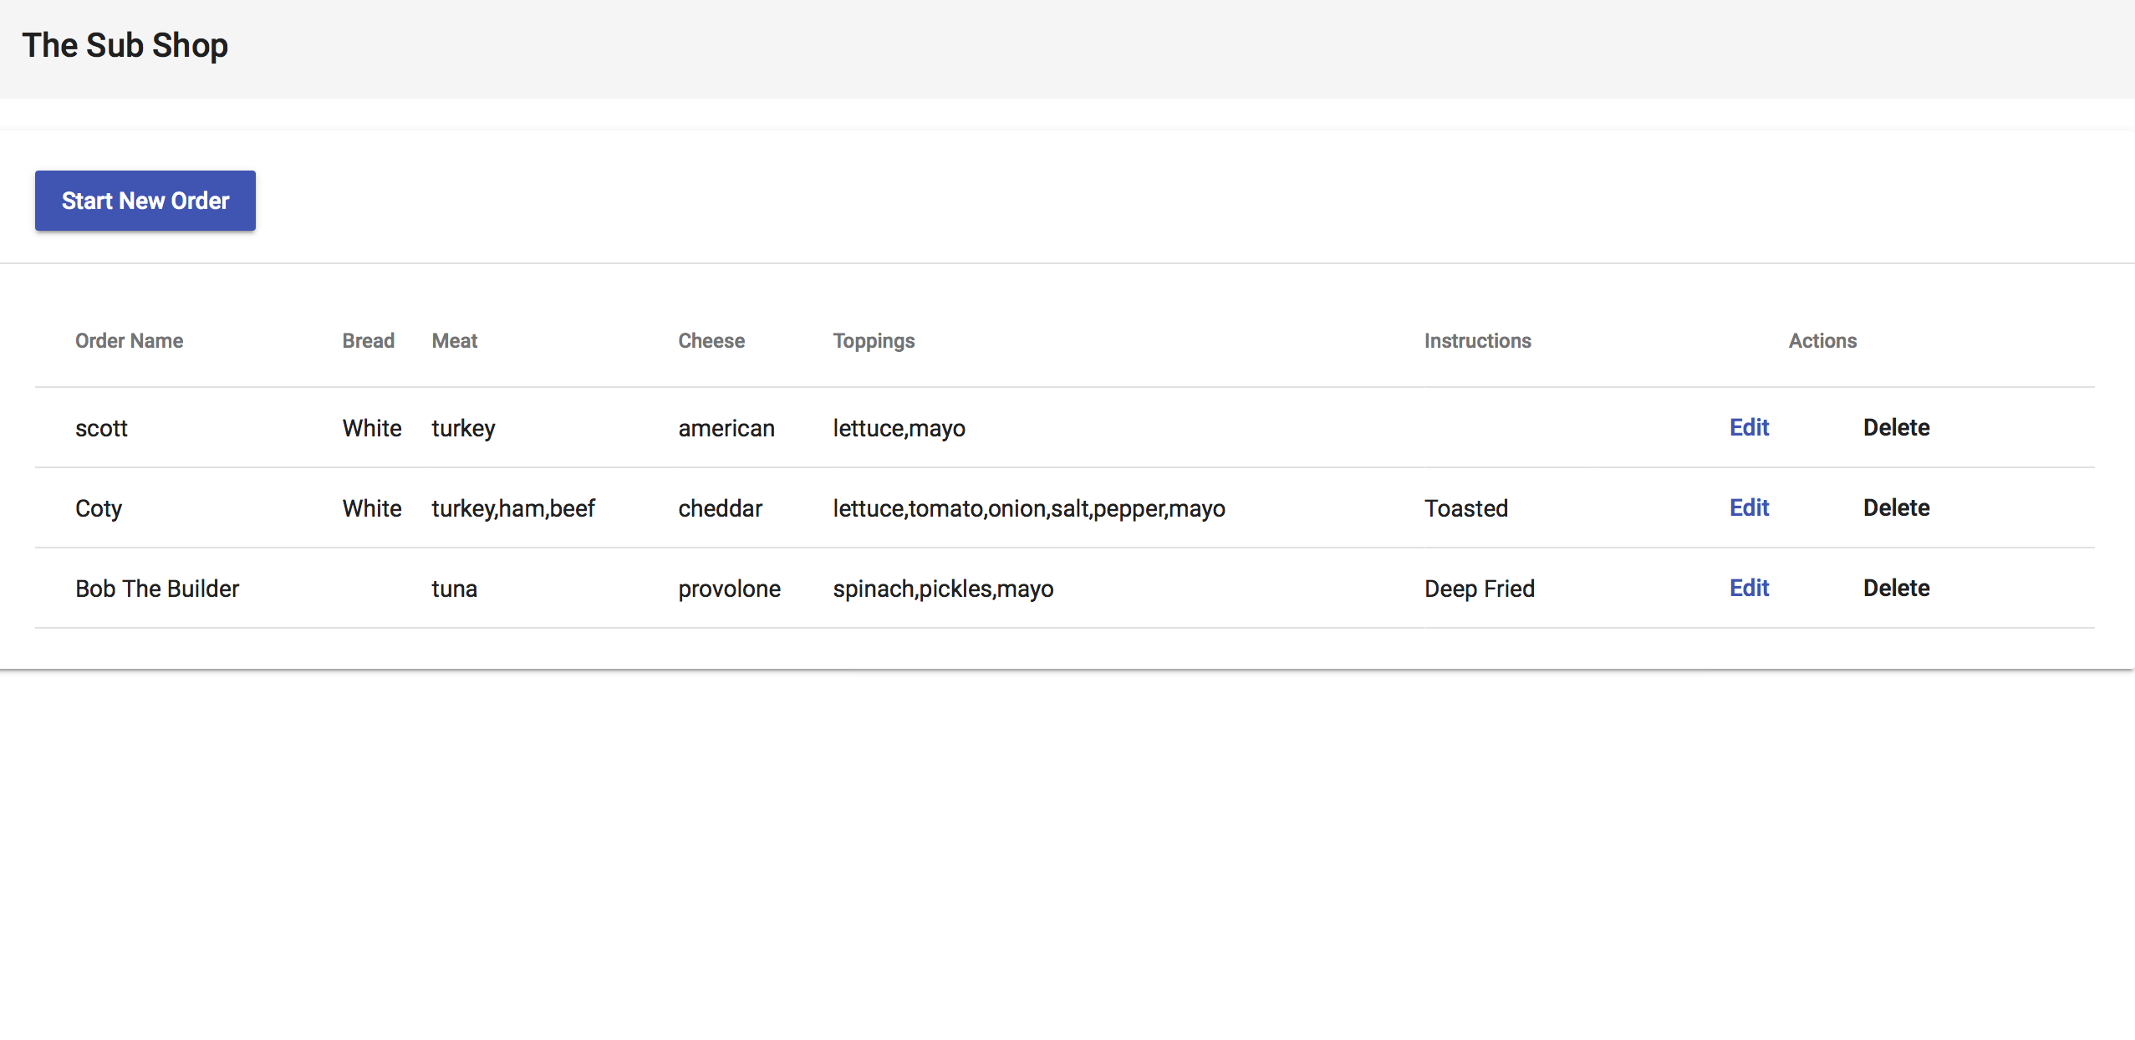
Ordering Page
This page allows Sub shop ordering
Start a New Sub Order
Previous orders stored in the system

Slide 3
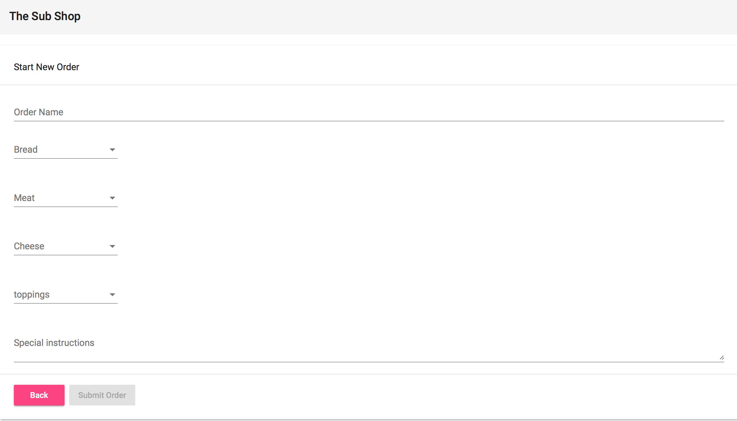
Order Name
Start by creating the name you would like on the order.

Slide 4
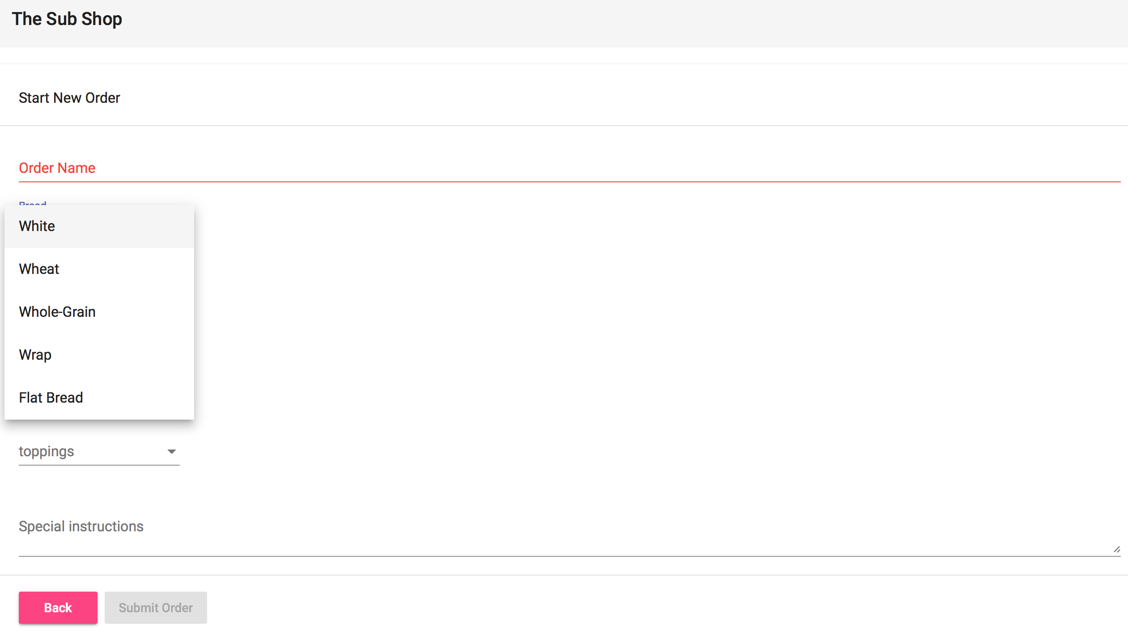
Bread Selection
This gives you a menu option to choose what type of bread you would like to build your sandwich on.

Slide 5
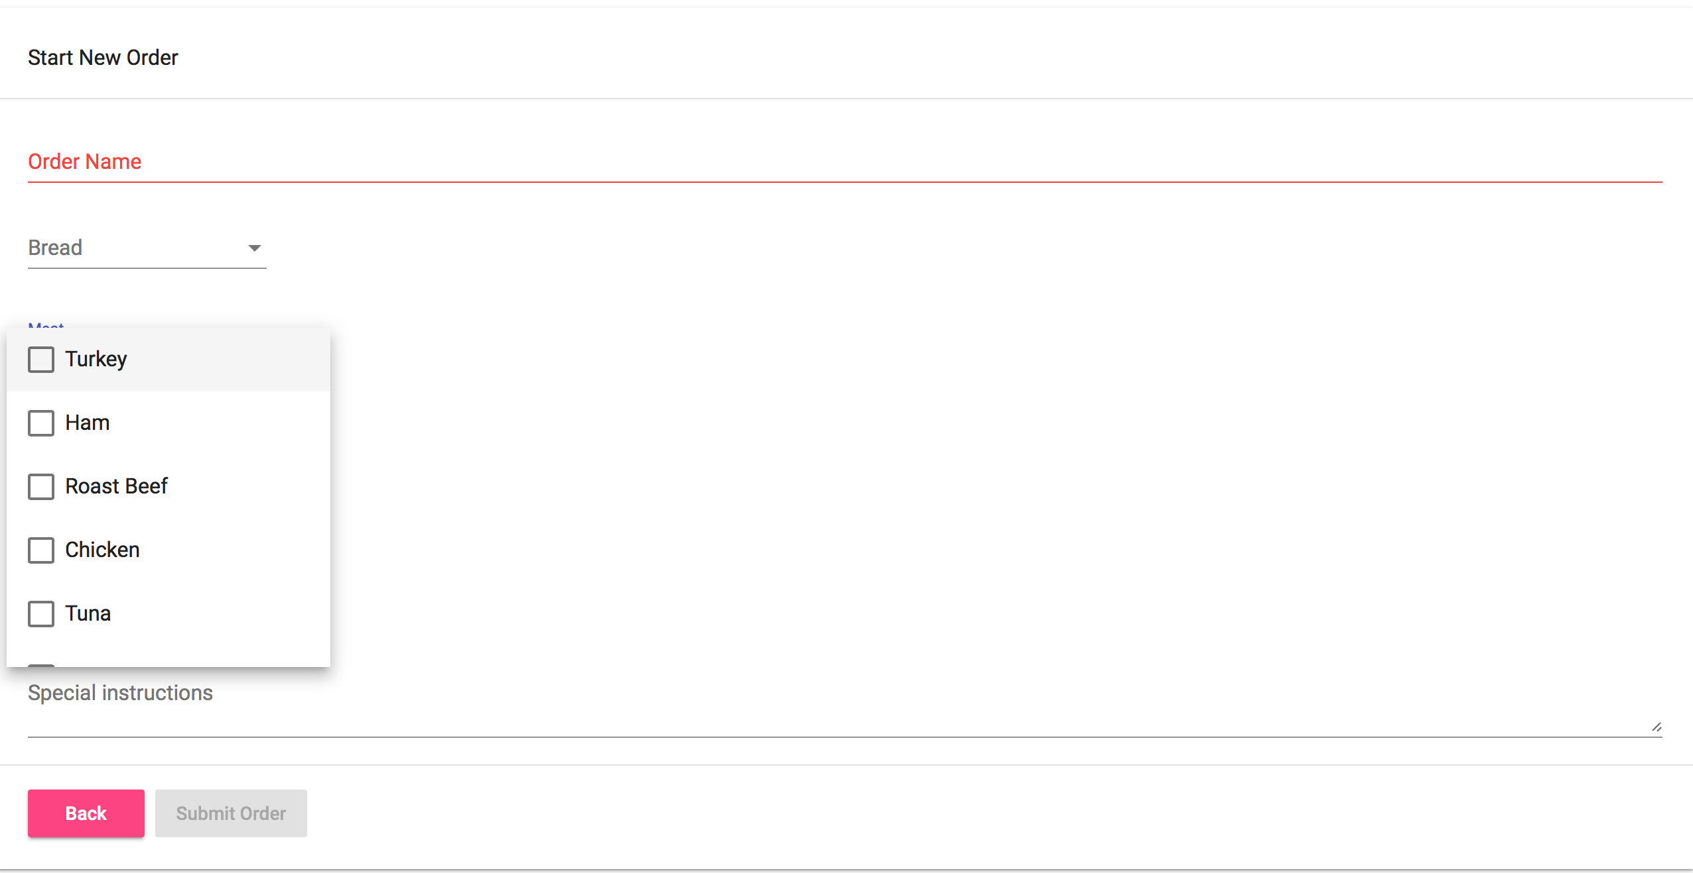
Meat Selection
This is a menu that allows multiple selections. This gives the customer the ability to mix and match.

Slide 6
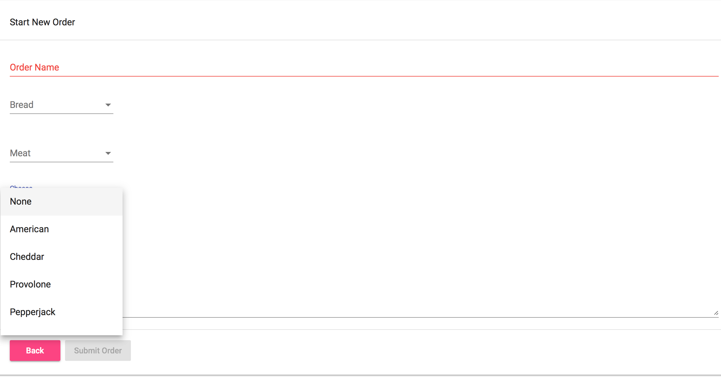
Cheese Selection
The customer has the ability to choose their cheese in a menu selection

Slide 7
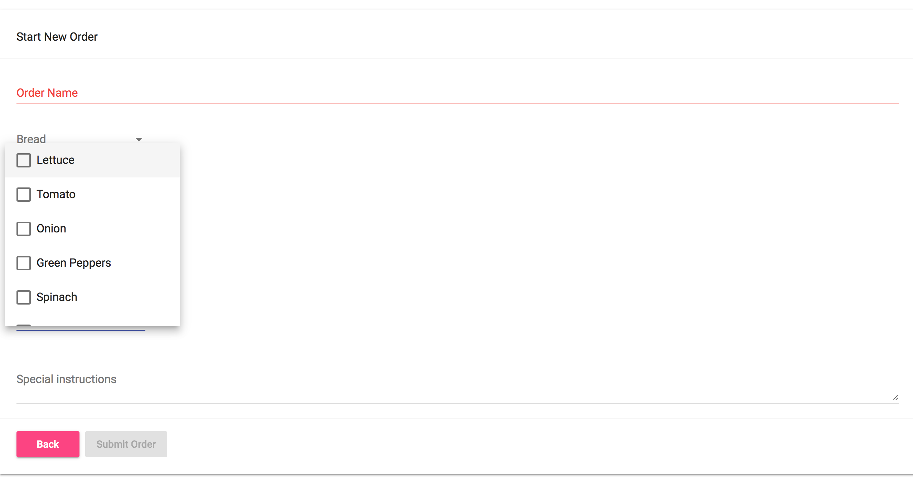
Topping selection
A toppings menu that allows for multiple selections.

Slide 8
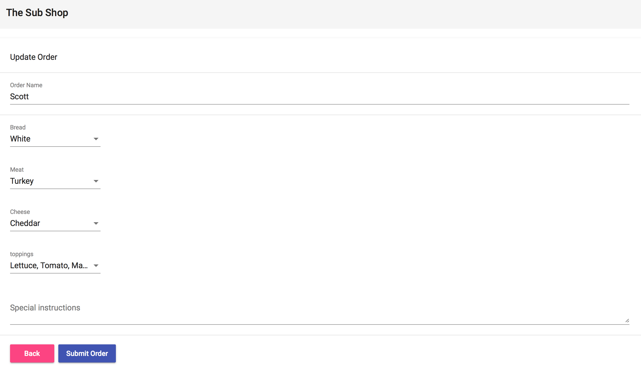
Special Instructions for the Kitchen
The last item is a text box that allows the user to add any special instructions for the preparation of food.
i.e “bread toasted”
Review and Submit Order

Slide 9
After an Order is Prepared
After an order is prepared the kitchen can then delete the pending order.

Slide 10
Editing the Order
If a mistake is made while placing the order, the kitchen can go look at there pending order and make the changes needed. ,

